Slide 1




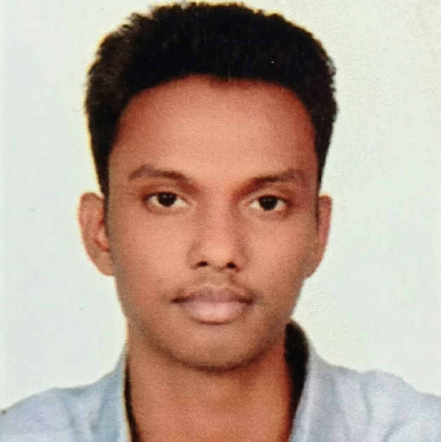






MetaHTR Towards Writer-Adaptive Handwritten Text Recognition
Ayan Kumar Bhunia ¹
Shuvozit Ghose*
Amandeep Kumar*
Pinaki Nath Chowdhury ^{1,2}
Aneeshan Sain ^{1,2}
Yi-Zhe Song ^{1,2}
¹ SketchX Lab, CVSSP, University of Surrey, UK
² iFlyTek-Surrey Joint Research Centre on Artificial Intelligence
*Interned with SketchX Lab
http://sketchx.ai
Notes:
Hi, I am Ayan Kumar Bhunia from SketchX Lab of University of Surrey. I’ll be presenting our work MetaHTR, Towards Writer-Adaptive Handwritten Text Recognition.

Slide 2
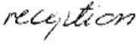
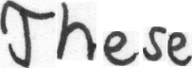
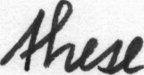
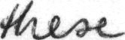
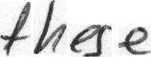
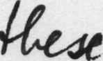
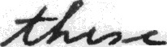
Handwritten Text Recognition (HTR)
HTR Model
reputation
Problem – “People have diverse handwriting styles”
Idiosyncratic style of writing characters
Cursive or non-cursive
Notes:
Handwritten Text Recognition aims to transcribe handwritten text to its digital content,
Which however is inherently difficult, as writer-specific handwritten text, are diverse across individual handwritten styles, where each style can be unique.
While some might prefer an idiosyncratic style of writing certain characters, others may choose a cursive style with uneven line-spacing.

Slide 3
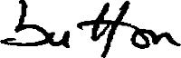

Traditional HTR Setup:
Model is trained in a single flow
No adaptation
Large dataset, synthetic data
Domain adaptation or generalisation
Existing Model
buHon
New style unobserved!
New MetaHTR Setup:
Meta-learn handwriting styles
Writer specialised HTR model
Style adaptation using a few examples.
Writer Adapted Model
button
Quick adaptation to new style!
Notes:
Traditional models are trained in a single flow on handwritten text images without adaptation and the trained model is used for recognition during Inference.
Although they utilize techniques like a large amount of training data, synthetic data, domain adaptation, or generalization methods to capture these style variations, they generalize poorly on unseen text-images as it is impossible to capture all unique style variations during training.
We therefore propose a meta learning-based writer-adaptive handwritten text recognition system, where the model learns to learn, or adapts to new writing styles with only a few samples during inference.

Slide 4
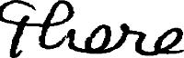

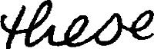
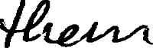
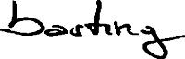
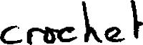
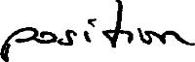
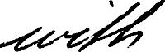
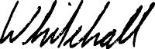
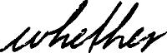
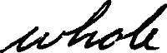
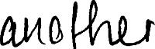

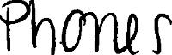
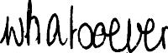
Challenges:
Writer A
Writer B
Writer C
Writer D
Contributions:
Meta Handwritten Text Recognition (MetaHTR) for writer style adaptation.
Meta-learn instance-wise weights, attending to character-specific adaptation.
Notes:
Handwritten styles are not only diverse across writers, but there are a few key characters per writer that show relatively larger style discrepancies, which in turn are crucial for adaptation.
Therefore, we introduce the problem of writer-adaptive handwritten text recognition, where the model adapts to new writing styles with only very few samples. We introduce a meta-learning framework to tackle this new problem, where instance-wise weights are made learnable for a character-specific loss, specifically designed for HTR.

Slide 5
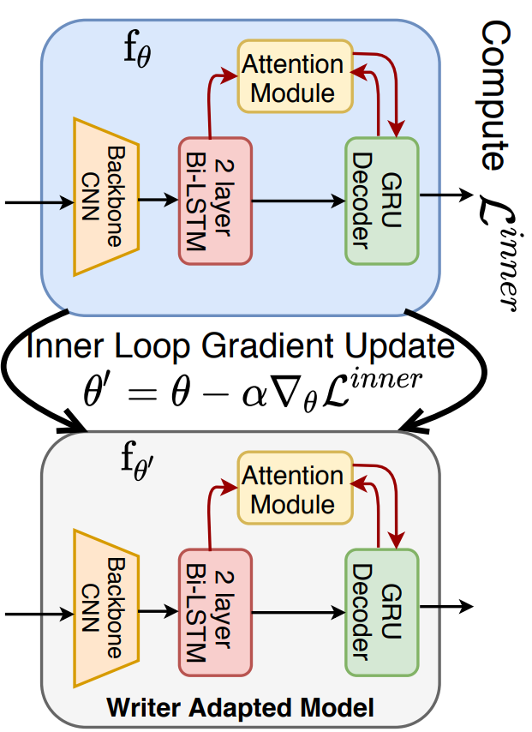
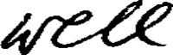
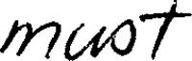
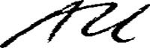
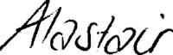
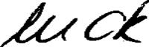
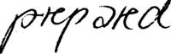
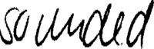
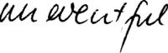
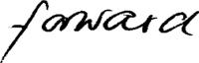
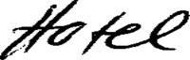
Meta Handwritten Text Recognition
Support
Set
…
Validation
set
…
Notes:
During inference, our MetaHTR framework exploits additional handwritten images, of a specific writer through a support set, and gives rise to a writer-adapted model, via a single gradient step update. Then, the writer adaptive model is used to perform handwritten text recognition for handwritten texts from that specific writer.

Slide 6
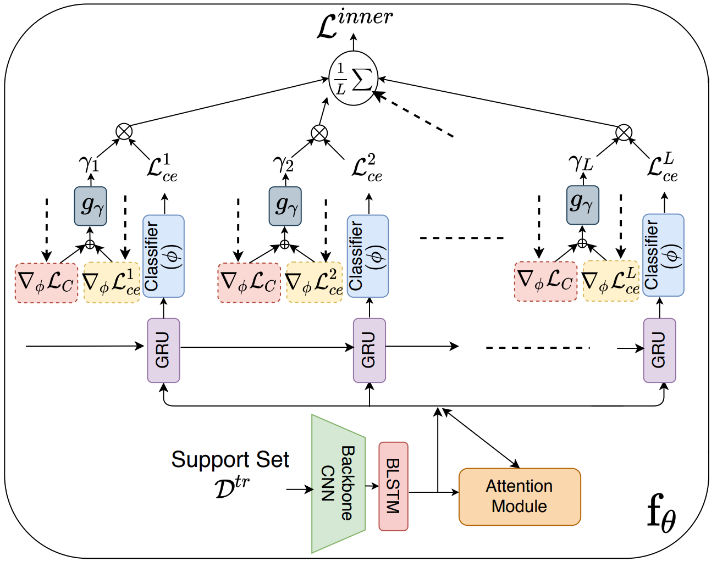
Learning-to-Learn weights for Character-wise Loss
Notes:
For character-specific loss, we calculate the gradient of t^{th} character-specific cross-entropy loss, with respect to the final classification layer, and then concatenate it with gradients of mean loss. The concatenated matrix is passed through a multi-layer perception network g gamma predicting a scalar weight value for t^{th} character-specific loss. Thus, the instance weighted inner loop loss is the weighted sum over all character loss.

Slide 7
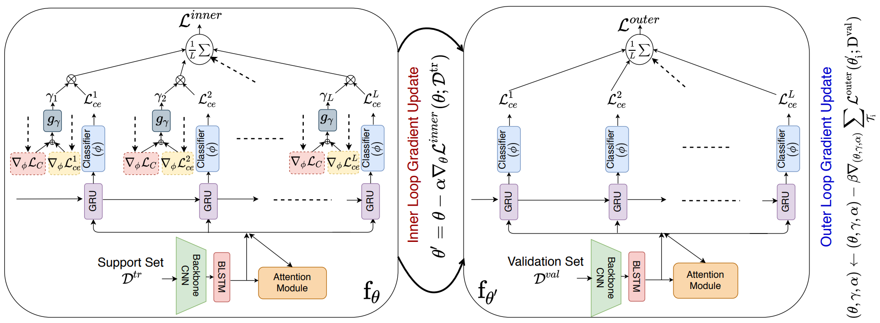
Bi-level Optimisation
Notes:
Our MetaHTR framework involves a bi-level optimization process. The inner loop optimization computes learnable character instance-weighted loss upon the support set, followed by obtaining a pseudo-updated model (theta dash ). This includes a learnable character instance specific weight prediction module (g-gamma) and learnable layer-wise learning rate parameters (alpha). We expect theta-dash to generalize well on remaining validation set, thus finally updating the meta-parameters by outer-loop loss over the validation set.

Slide 8
Experiments
Datasets: IAM^{[1]} & RIMES^{[2]}
Models: HTR models ASTER^{[3]}, SAR^{[4]}, and SCATTER ^{[5]}
Evaluation Metric:
Word Recognition Accuracy with-Lexicon (L)
Word Recognition Accuracy with No-Lexicon(NL)
Baselines:
Domain Adaptation Approach
Domain Generalisation Approach
Generative Approach
Learning Augmentation Approach
Meta-Learning based Adaptation
[1] U-V Marti and Horst Bunke. The iam-database: an english sentence database for offline handwriting recognition. IJDAR, 2002.
[2] Emmanuele Grosicki and Haikal El Abed. Icdar 2009 hand- ` writing recognition competition. In ICDAR, pages 1398– 1402, 2009.
[3] Baoguang Shi, Mingkun Yang, Xinggang Wang, Pengyuan Lyu, Cong Yao, and Xiang Bai. Aster: An attentional scene text recognizer with flexible rectification. T-PAMI, 2018.
[4] Hui Li, Peng Wang, Chunhua Shen, and Guyu Zhang. Show, attend and read: A simple and strong baseline for irregular text recognition (SAR). In AAAI, 2019.
[5] Ron Litman, Oron Anschel, Shahar Tsiper, Roee Litman, Shai Mazor, and R Manmatha. Scatter: selective context attentional scene text recognizer. In CVPR, 2020.
Notes:
We evaluate our model, on IAM and RIMES HTR dataset, utilizing three HTR models ASTER, SAR, and SCATTER, with Word Recognition Accuracy for both with-and-without Lexicon evaluation metric.
Due to absence of prior work on writer-adaptive handwritten text recognition, we design several strong baselines from perspectives of, Domain Adaptation, Domain Generalization, Generation, Learning Augmentation, and Meta-Learning Based Adaptation.

Slide 9
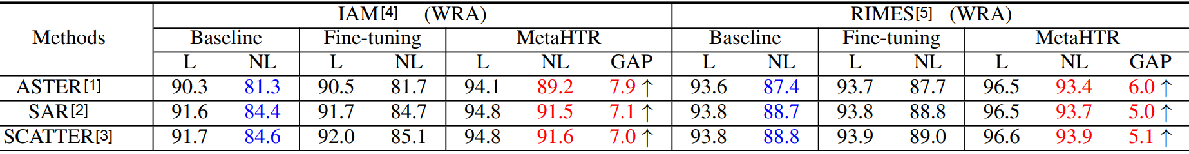
Quantitative Results
Comparison among Baselines, naive Fine-tuning, and MetaHTR for using L and NL.
[1] Baoguang Shi, Mingkun Yang, Xinggang Wang, Pengyuan Lyu, Cong Yao, and Xiang Bai. Aster: An attentional scene text recognizer with flexible rectification. T-PAMI, 2018.
[2] Hui Li, Peng Wang, Chunhua Shen, and Guyu Zhang. Show, attend and read: A simple and strong baseline for irregular text recognition (SAR). In AAAI, 2019.
[3] Ron Litman, Oron Anschel, Shahar Tsiper, Roee Litman, Shai Mazor, and R Manmatha. Scatter: selective context attentional scene text recognizer. In CVPR, 2020.
[4] U-V Marti and Horst Bunke. The iam-database: an english sentence database for offline handwriting recognition. IJDAR, 2002.
[5] Emmanuele Grosicki and Haikal El Abed. Icdar 2009 hand- ` writing recognition competition. In ICDAR, pages 1398– 1402, 2009.
Notes:
Figure shows results of evaluation.
While the performance gain on IAM is around 7 percent, in RIMES it is around 5 percent.

Slide 10
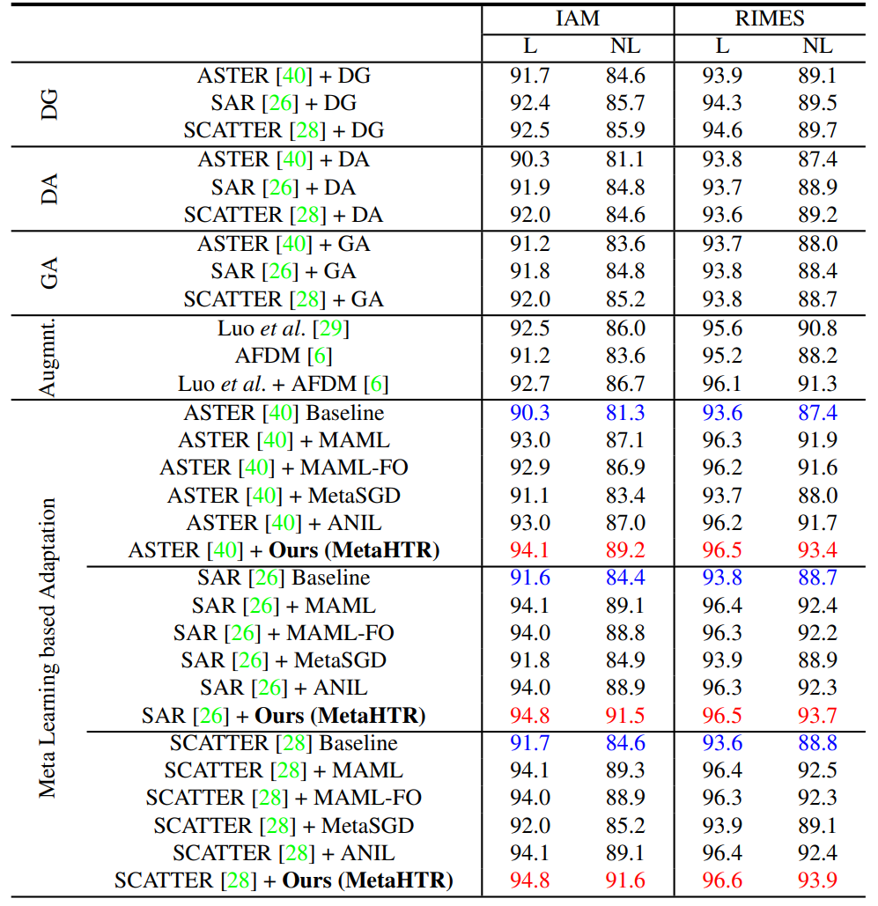
Quantitative Results:
Performance analysis with
different approaches
Notes:
Along with the baselines, We also compare our model with Meta-Learning-based methods like typical MAML, first-order MAML, Meta-SGD, and ANIL. Out of all the approaches from different perspectives, our Meta-H T R performs the best for all three HTR models.

Slide 11
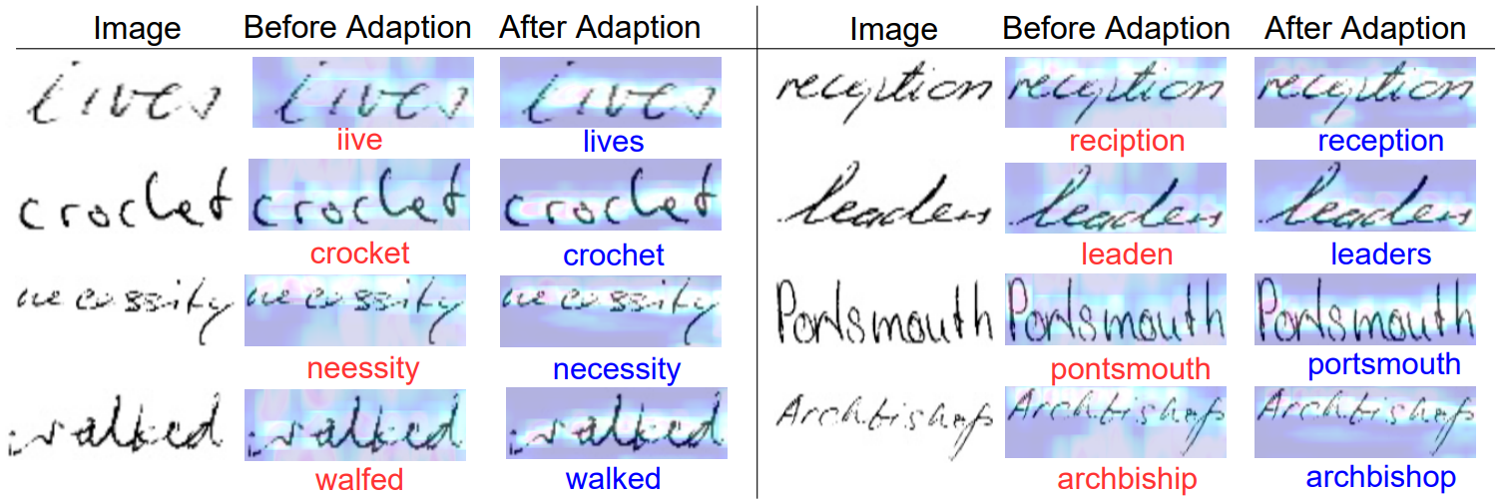
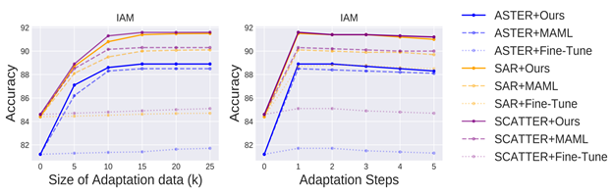
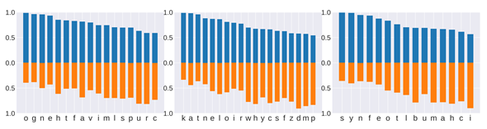
Ablative studies
Attention Map
Visualization
Character-sets of three writers show varying W.R.A, signifying different levels of discrepancy against MetaHTR’s initialization parameter. Characters having lower accuracy mostly get higher weights (orange) , and vice versa, in the inner-loop adaptation process.
Unconstrained W.R.A of MetaHTR with varying adaptation set-size (k), and adaptation steps.
Notes:
Additionally, the more consistent character-aligned attention map after adaptation justifies our approach visually.
Our model performs best with an optimal adaptation set-size of 10-15 samples and just one inner loop update .
Varying accuracy against different character sets shows varying levels of discrepancy against initialization parameter. Furthermore, characters with low accuracy mostly get higher weights , and vice versa, during inner-loop adaptation process.

Slide 12

http://sketchx.ai
Notes:
Thank you.

